Slide 1
Object Detection in TensorFlow
Nissim Cantor, Avi Radinsky, Jacob Silbiger
GitHub: https://github.com/ndcantor/tensorflow-street-classifier

Slide 2

Our Mentor, Gershom Kutliroff
Chief Science Officer, Taranis
CTO & Founder, ClearVuze
Principle Engineer, Intel
CTO & Founder, Omek Interactive
Chief Scientist, IDT Video Technologies
Linkedin

Slide 3
Goal
The goal of our project was to create an image classification and object detection model that simulates how one would be used in a self driving car
Our model uses a neural network to draw boxes around and label objects in an image
Brief overview of model architecture:
TensorFlow transfer learning image classifier
Object detection using:
Selective search
Non-maximum suppression

Slide 4
Background

Slide 5
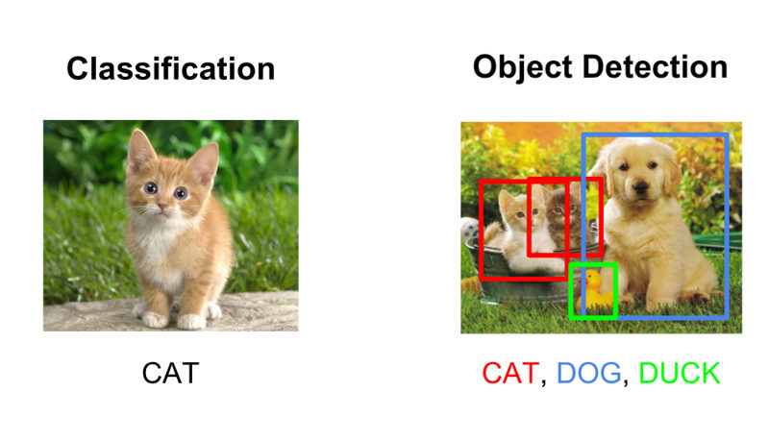
Image Classification vs. Object Detection
Image classification - determining the classification of a given image (ex. Is this a photograph of a cat or a dog).
Object detection - detecting the an image of a certain class within a larger picture (ex. Within this picture of many animals, draw a bounding box around all relevant animals and identify them.)

Slide 6
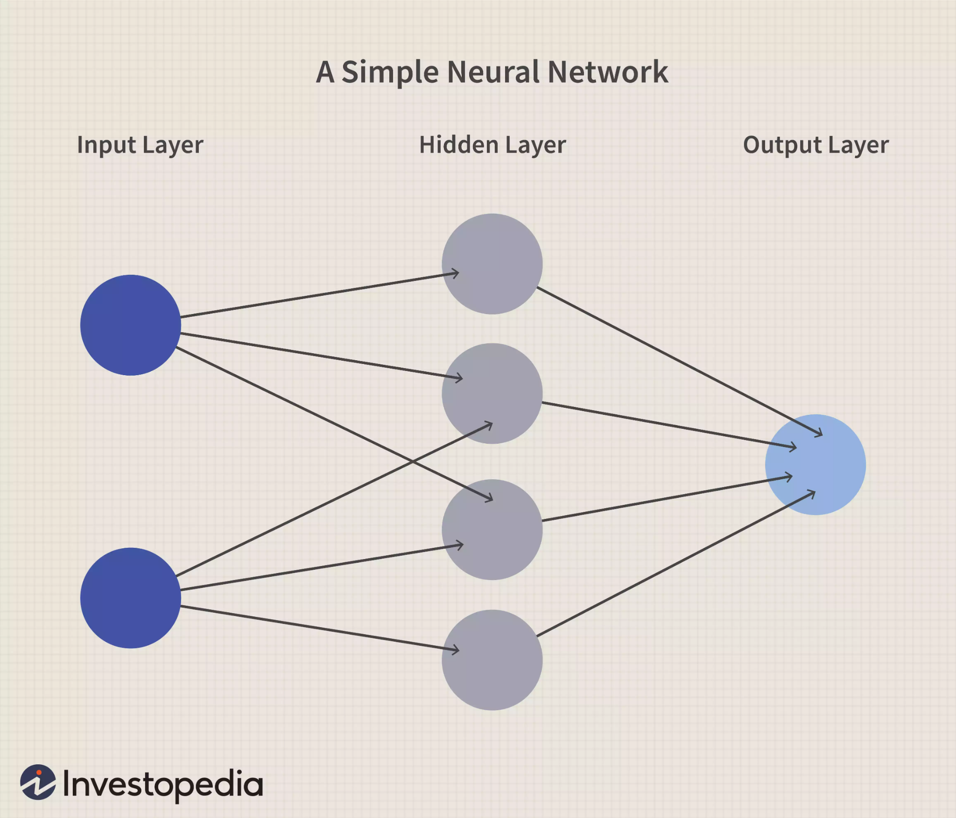
Neural Networks
“A neural network is a series of algorithms that endeavors to recognize underlying relationships in a set of data through a process that mimics the way the human brain operates. In this sense, neural networks refer to systems of neurons, either organic or artificial in nature.” (investopedia.com)
It turns out that neural networks often produce generalizable results.
Its best to view them as a black box.

Slide 7
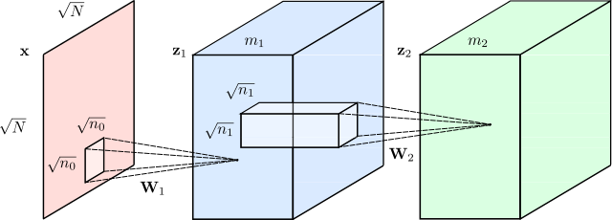
Convolutional Neural Networks
A class of Neural Networks commonly used in computer vision applications
Wikipedia

Slide 8

VGG16 (Simonyan and Zisserman)
A CNN architecture developed by Oxford University researchers that showed high rates of success in image recognition.
It showed that ‘deep’ Neural Networks might be more effective than ‘large’ neural networks.
Wiki

Slide 9
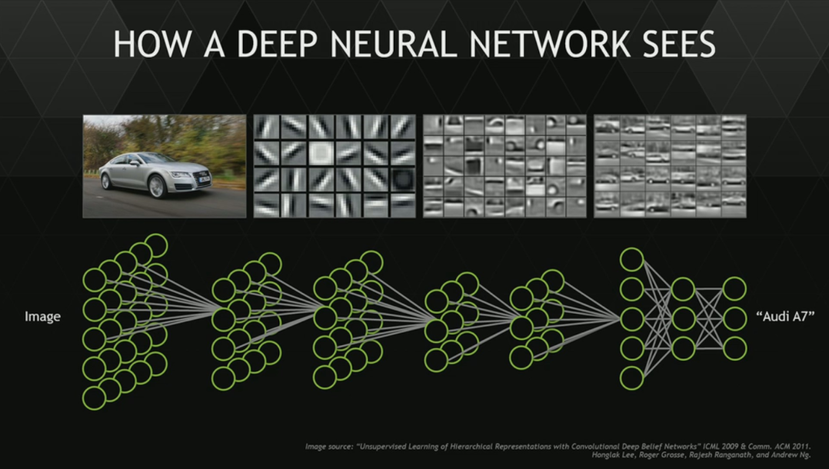
But how does a Neural Network actually work?
Currently, the prevalent theory as to how a neural network works is that each layer is detecting a specific characteristic of the image that it sees, and as you travel through the layers of the network the layers begin detecting increasingly complex characteristics.

Slide 10
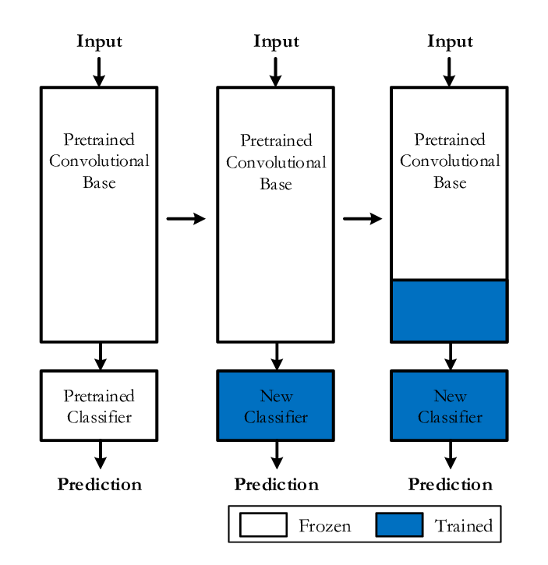
Transfer Learning
The characteristic detecting nature of neural networks allows us to leverage pre-trained networks on different problems with minimal changes.
The changes can be as minimal as retraining the last layer in the network but sometime can involve training several or more of the last layers in a network.

Slide 11
Fine Tuning
Through tweaking the parameters of a neural network, one can try and maximize its accuracy. However, each tweak of the parameters has its positives and negatives.
Running through the data numerous times (multiple epochs)
It can make up for small data sizes (+)
It can cause overtraining in the model (-)
Increasing the size of the neural network
Accuracy can increase (+)
It becomes easier to overtrain the model (-)

Slide 12
TensorFlow Street Classifier

Slide 13
Data
Since we wanted to simulate a model that might be used in a self driving car, we decided to train our network to recognize everyday objects found in city streets
Classes:
Bicycle
Car
Motorcycle
Person
Train

Slide 14
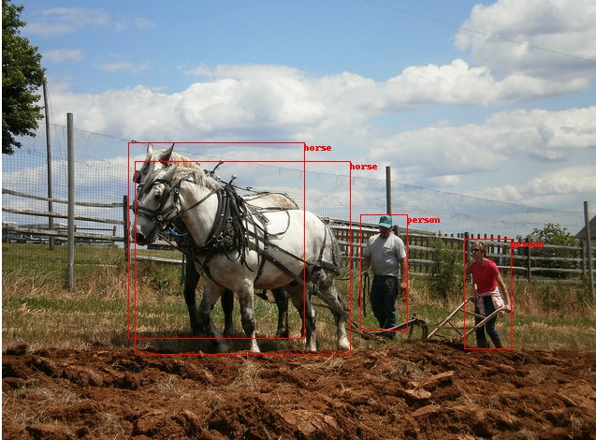
Datasets
We used the COCO (Common Objects in Context) Dataset as it contains high-quality images of these objects in the real-life scenes.
We also used Open Images V6 Dataset to supplement some more images for the small sized classes.
Both datasets contained labels and bounding boxes which we used as ground truth to train our model.

Slide 15
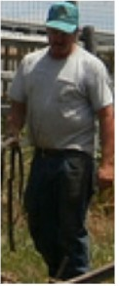
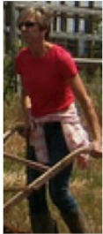
Generating Train/Test Images
All bounding boxes from every image in the datasets were cropped and saved inside of its class folder (crops of cars were stored in the ‘car’ folder, etc)
These cropped images were then split into train and test folders
Shift augmentations were performed for crops in the train folder in order to help the model learn more about the features of each class.
These crops were then used to train the model
Any image from the datasets which had no bounding boxes of the classes we were training the machine to recognize were sliced into quadrants, with each quarter being placed into a ‘background’ class folder
The purpose of the background class is to allow the model to classify unknown objects as ‘background’ instead of mistakenly classifying it as one of the five other classes.
In total the model was trained on over 848,000 cropped images

Slide 16
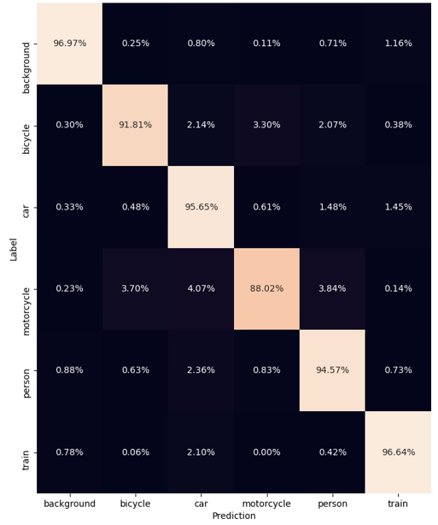
Classification Model
Our model uses transfer learning using the MobileNetV2 architecture
The model ran for 20 epochs, the first 10 with a learning rate of 0.0001 and the last 10 with a learning rate of 0.00001
After training, our model obtained a score of over 95% test accuracy
The figure to the right is a confusion matrix, showing how accurate the model was for each of the 6 classes

Slide 17
Object Detection
After classifying each image, the next step is object detection
Object detection works by sending image crops into the classification model and drawing boxes around all crops that were classified as one of the non-background classes
We tried two different methods of generating crops to send to into the classifier:
Sliding windows
Selective search

Slide 18
Sliding Windows
Sliding windows works by passing a fixed-size rectangle across the image, cropping the image and saving the crop’s location on the original image. The image is then enlarged and the process is repeated in order to generate smaller boxes to help find smaller objects.
The process of repeatedly enlarging the image is called pyramid scaling
The crops are then sent to the classification model to be classified. The model outputs the original image with bounding boxes drawn around all crops which were classified as non-background objects

Slide 19
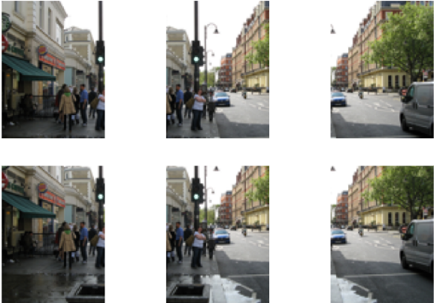
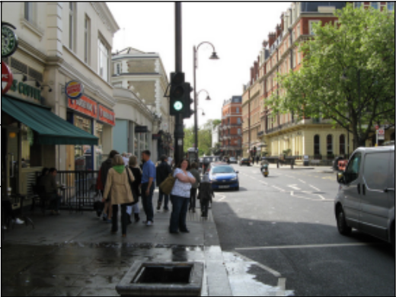
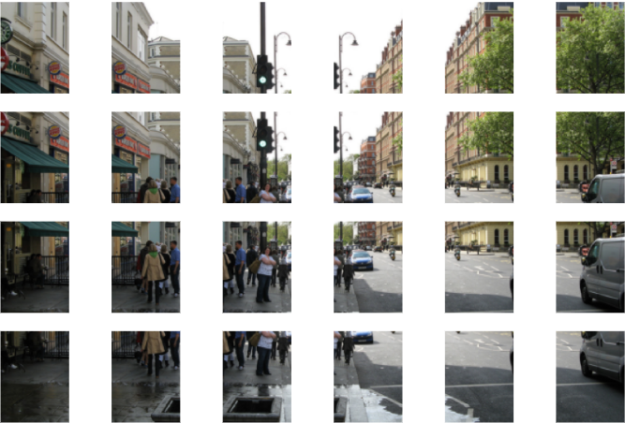
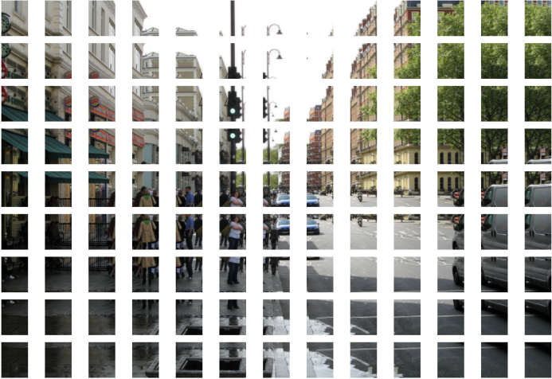
Example
Image crops with pyramid scaling
Original Image

Slide 20
Problems with Sliding Windows
The sliding windows method had two main problems:
It is a brute force method, so it took a long time to run
The boxes all had a fixed size, so it was hard to classify multiple classes of objects that had different shapes

Slide 21
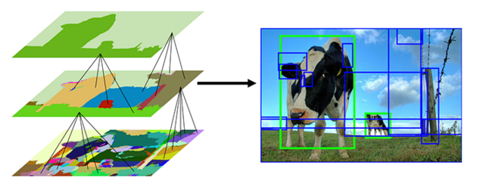
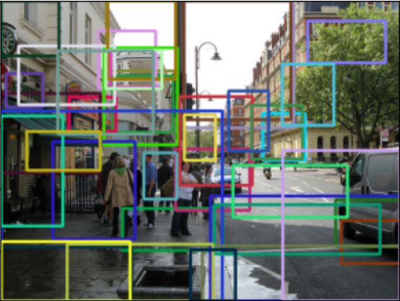
Selective Search
Selective search is an algorithm that works by creating crops based on certain criteria in the image
color, texture, shape, size
This produces boxes of different shapes and sizes, and doesn’t work by repeatedly running brute-force across the image
Crops are then sent to the model to be classified
Our model uses selective search as it is faster and more accurate than sliding windows
(Diagram from pyimagesearch.com)

Slide 22
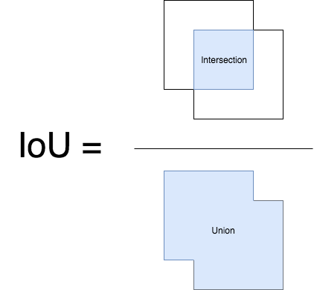
Non-maximum Suppression (NMS)
After the cropped regions are classified, many adjacent regions will be classified as the same object and will overlap with each other. In order to choose only the best crop for each object, we run a non-maximum suppression algorithm to remove all overlapping regions.
How NMS works:
Select the crop whose classification the model is most confident about
Remove all bounding boxes whose overlap whose intersection over union (IOU) with the selected crop is above a certain threshold
Output all remaining bounding boxes which are less than the overlap threshold

Slide 23
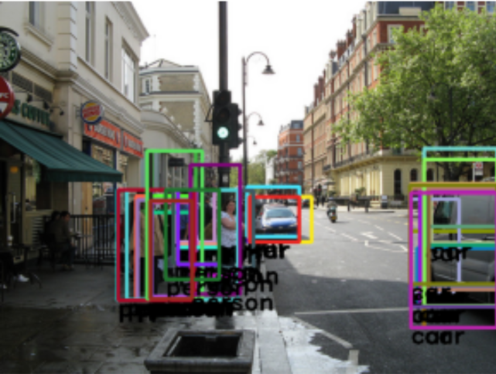
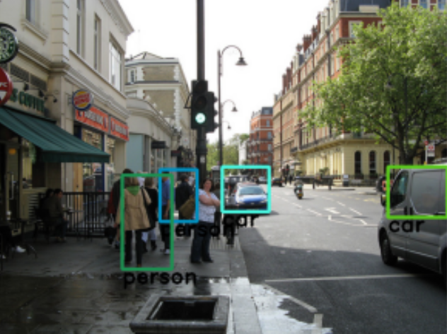
Before NMS
After NMS

Slide 24
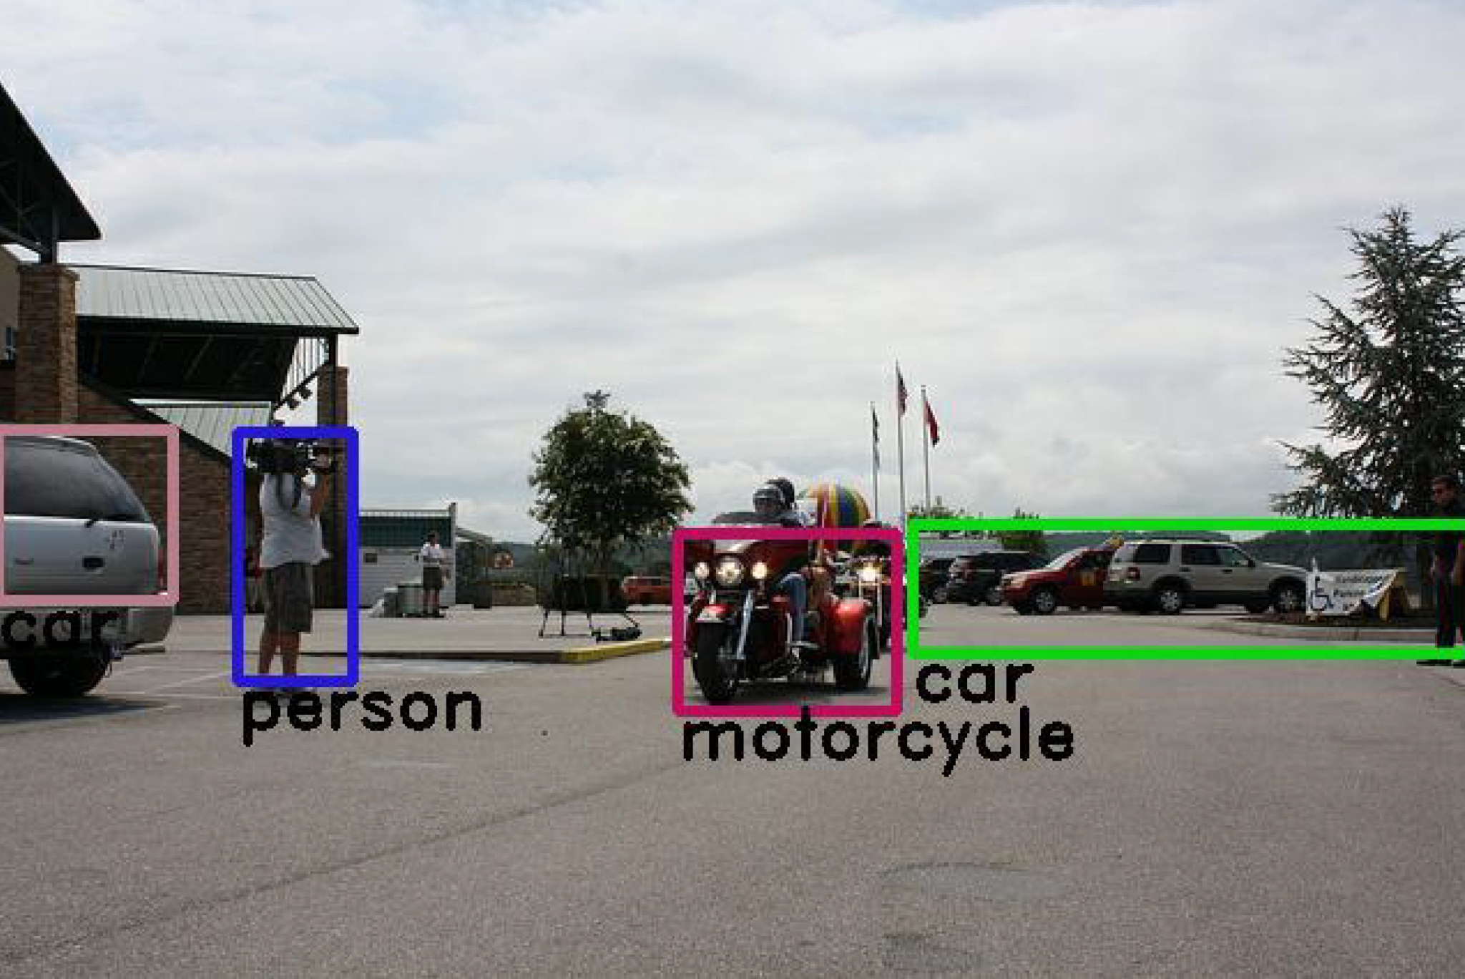
Results
Our model is able to classify images with relatively high accuracy
We were successful in creating an image detection model that can detect if an object of any of our classes is in the image
With our GitHub repo, you can download the data and train your own model

Slide 25
Further Exploration
How we might be able to further improve our model:
Uneven training data class sizes led our model to be skewed toward the bigger classes. One way to prevent this would be to find more data to increase the size of the smaller classes
Another way to help this problem is to use a focal loss function. This loss function helps the model adjust its weights more evenly by more drastically adjusting weights when it mistakenly classifies an object of a smaller class than an object of a bigger class
Another aspect to improve is the accuracy of the bounding boxes. In order to have tighter boxes, we would be able to run a bounding box regression algorithm

Slide 26
Do it Yourself - How to Build and Run Our Model
Pre-requisites:
Python 3.7+
CUDA 10.0
cuDNN 7.5.1
Run:
To clone the repo - git clone https://github.com/ndcantor/tensorflow-street-classifier.git
Install required Python libraries - pip3 install -r requirements.txt
Download data, build, train, and run inference on the model - python3 street_classifier.py
Results:
The model’s train, validation, and text accuracies will be printed on the screen
A confusion matrix as well as sample test images will be saved to disk

